Slide 1
A Global Leader in Surveillance
Data Distribution & Conversion
Systems

Slide 2
Sunhillo Corporation Global Presence
256 FAA Facilities
Over 50 Countries
www.Sunhillo.com

Slide 3
Sunhillo SureLine® Core Software
Sunhillo SureLine software is the backbone of Sunhillo Corporation’s surveillance gateway products:
(RICI, Longport, Brigantine SGP, Ventnor and Margate II ADS-B)
SureLine Functionality:
Conversion
Translation
Bridging dissimilar networks
Analyzing data
Connecting surveillance sources to air-traffic automation systems.
www.Sunhillo.com

Slide 4
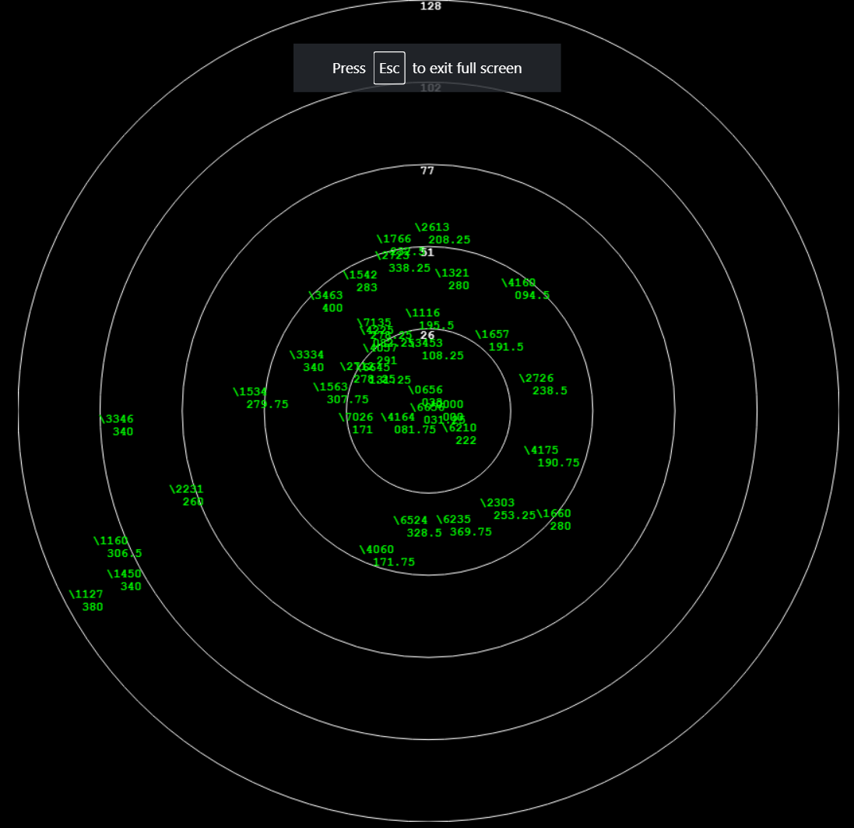
Sunhillo SureLine® Core Software
Sureline ADS-B Data Flow Example
Filtering
Capability
Built in Radar Display
www.Sunhillo.com

Slide 5
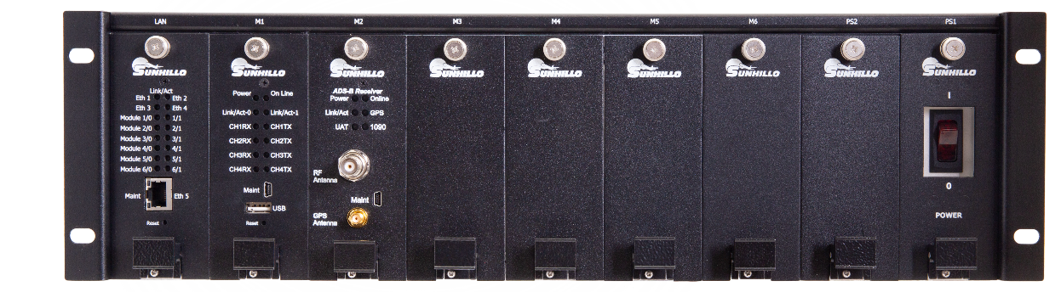
Surveillance Data Distribution & Conversion Products
Powered by Sunhillo SureLine® Core Software
Surveillance and sensor data formatting, filtering, and conversions
TCP/IP, UDP/IP, and Serial to LAN Protocol Conversions
Gigabit Ethernet
Rack Mountable
RICI 5000
Longport
Brigantine
Ventnor
www.Sunhillo.com

Slide 6
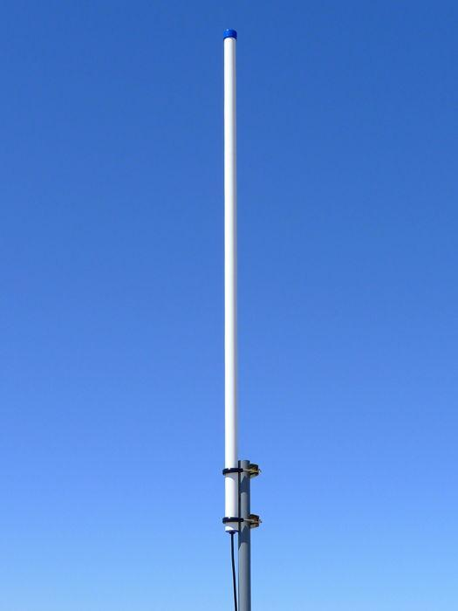
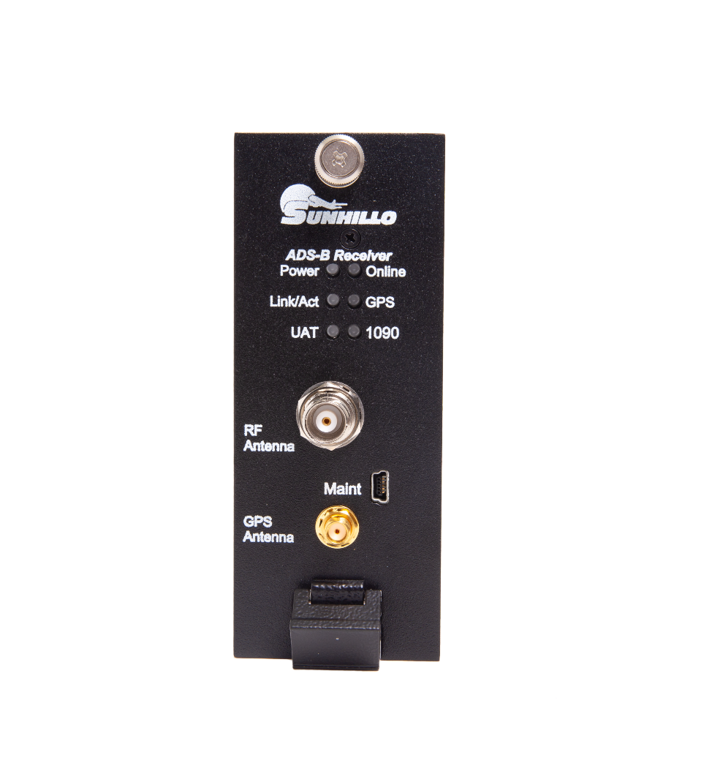
Sunhillo ADS-B Receiver
Accepts and decodes 978MHz UAT and 1090MHz ADS-B
Exceeds DO-260B and DO-282 standards
Front panel GPS, RF antenna input connections
Rack mountable or table-top compact design
Deployed to the US Navy, US Army, US National Guard
www.Sunhillo.com

Slide 7
Surveillance Data Distribution System (SDDS)
IP/IP Surveillance Data Distribution
250,000 individual messages/sec scalable throughput
ASTERIX validation on all messages
All standard ASTERIX messages supported
New or special categories added via user XML definition files
Instant switchover with no data loss
Duplicate message removal
Flexible Graphical configuration Editor
Features
Geo filtering
Conversion among Radar formats
Realtime Data displays
Radar recording and Database Connectors
Over 60 optional nodes for filter and output formats
User tool kit for data modification
Web Management and Control
www.Sunhillo.com

Slide 8
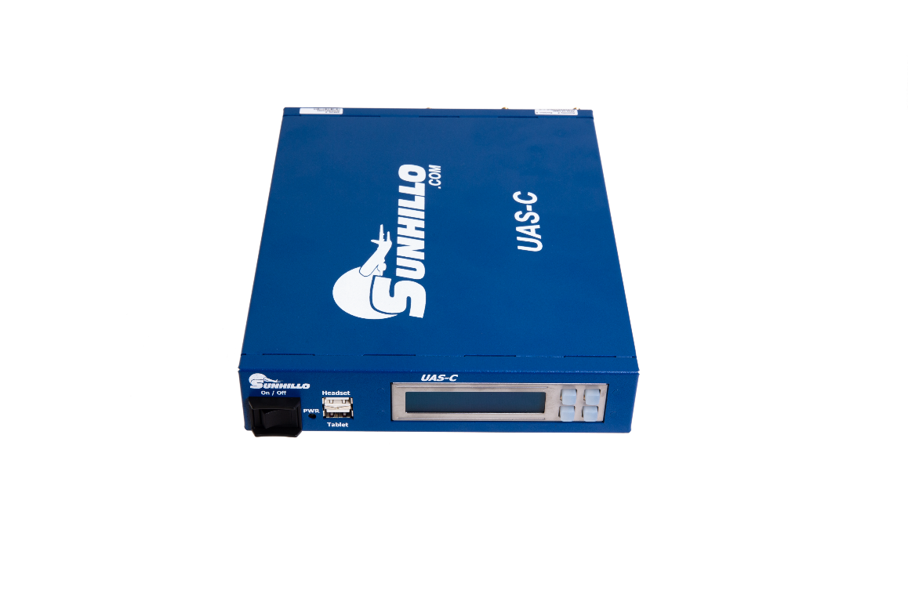
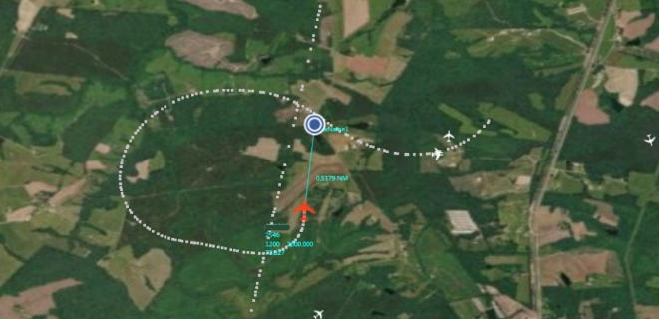
Sunhillo UAS-Connector (UAS-C)
Track UAS of any size without Radar or ADS-B
Provides UAS Pilot See & Avoid display
Converts & distributes UAS location to ATC in local ATC format (ASTERIX etc)
Voice communications to/from ATC and UAS Pilot on proper radio frequency
Provides a system capable of integration into almost any ATC/ATM/UTM for regional situational awareness and Emergency Management arenas
www.Sunhillo.com

Slide 9
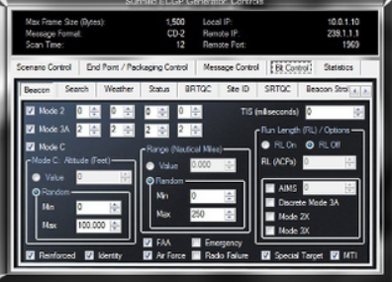
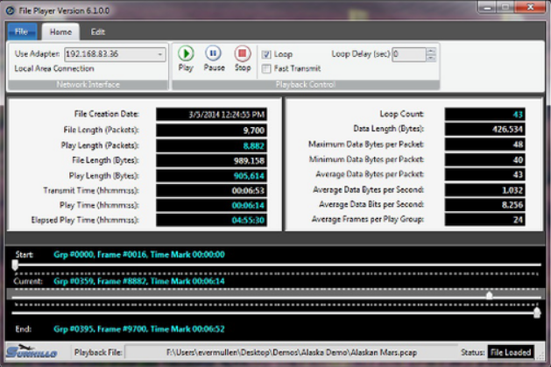
Surveillance Software Tools
ECGP Generator
Load Generator and Conversion Test Tool
Generates CD-1, CD-2, ASR-9, MAR, ARSR-3, ARSR-4, and more
File Player
Surveillance Data Playback
Test systems before they go live with captured data from the incoming network
Sunhillo ASTERIX Toolkit
Captures and decodes State-of-the-art and legacy surveillance radar formats for analysis
Break out individual fields
www.Sunhillo.com

Slide 10
Trusted Partner to the US FAA, DoD
Expertise Across All Functional Areas:
Test & Evaluation
Training, Testing, Logistics
Project & Program Management
Systems Integration
System, Software, & Hardware Engineering
www.Sunhillo.com

